Slide 1

An Empirical Study on the Discrepancy between Performance Testing Results from Virtual and Physical Environments
Master Thesis Defense M. Moiz Arif
Supervisors: Dr. Shihab & Dr. Shang
July, 2017
Notes:
My name is moiz and today I will talk about my 2 years under supervisors

Slide 2
What are performance tests?
Performance assurance activities: ensuring software meets performance requirements.
Mimicking user behaviour.
Notes:
A quantitative measure of how the software performs Mimicking user behaviour: Applying a workload and checking performance metrics Why performance is imp? Amazon example.

Slide 3

What are performance tests important?
Amazon estimates that a one-second page-load slowdown can cost up to $1.6 billion.
https://tctechcrunch2011.files.wordpress.com/2014/01/aws_logo.jpg
Notes:
A quantitative measure of how the software performs Mimicking user behaviour: Applying a workload and checking performance metrics Why performance is imp? Amazon example.

Slide 4

What are performance tests important?
Healthcare.gov failed to rollout successfully because of lack of performance testing
http://dailysignal.com/wp-content/uploads/140918_HealthCare_Attkisson.jpg
Notes:
A quantitative measure of how the software performs Mimicking user behaviour: Applying a workload and checking performance metrics Why performance is imp? Amazon example.

Slide 5




How is a performance test carried out?
requests
requests
Performance metrics
requests
Large-Scale System
Notes:
“New version” in the new slide A guy with a question mark? Answer virtual machines.

Slide 6

Background: Types of performance analysis
Single performance metric
Relationship between performance metrics
Statistical modeling on performance metrics
[Nguyen, T.H. et al,ICPE,2012]
[Cohen, I.. et al,OSDI,2004]
[Shang, W. et al,ICPE,2015]
Notes:
We first conduct background study and see how performance tests are analyzed. 3 ways of analyzing it. single performance metric: the trends and distributions of each performance metric
the relationship between the performance metrics: the correlations between every two performance metrics
statistical performance models: the models that are built using performance metrics to predict the overall performance of the system.
Prior research focused on the overhead of virtual environments without considering the impact of such overhead on performance testing and assurance activities. In

Slide 7

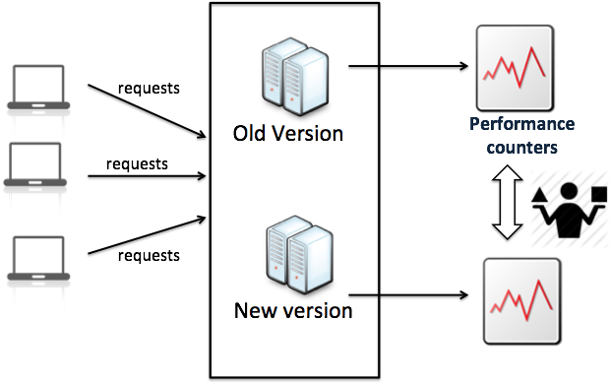
How is a performance regression detected?
What if you need to modify your environment?
Image: https://openclipart.org/detail/191766/question-guy
Notes:
Performance tests need large amount of resources accompanied by frequent changes in the environment. Performance analysts often rely on virtual machines.

Slide 8

How is a performance regression detected?
What if you need to modify your environment?
VIRTUAL MACHINES!
Image: https://openclipart.org/detail/191766/question-guy https://openclipart.org/detail/167198/two-virtual-machines
Notes:
Performance tests need large amount of resources accompanied by frequent changes in the environment. Performance analysts often rely on virtual machines.

Slide 9
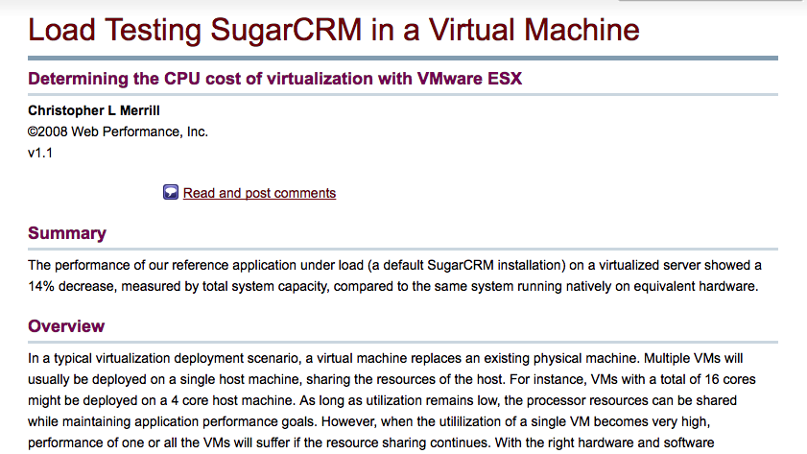
Examples from the industry
https://www.webperformance.com/library/reports/Virtualization2/index.html

Slide 10
Examples from the industry
“The performance of our reference application under load (a default SugarCRM installation) on a virtualized server showed a 14% decrease, measured by total system capacity, compared to the same system running natively on equivalent hardware.”
https://www.webperformance.com/library/reports/Virtualization2/index.html

Slide 11
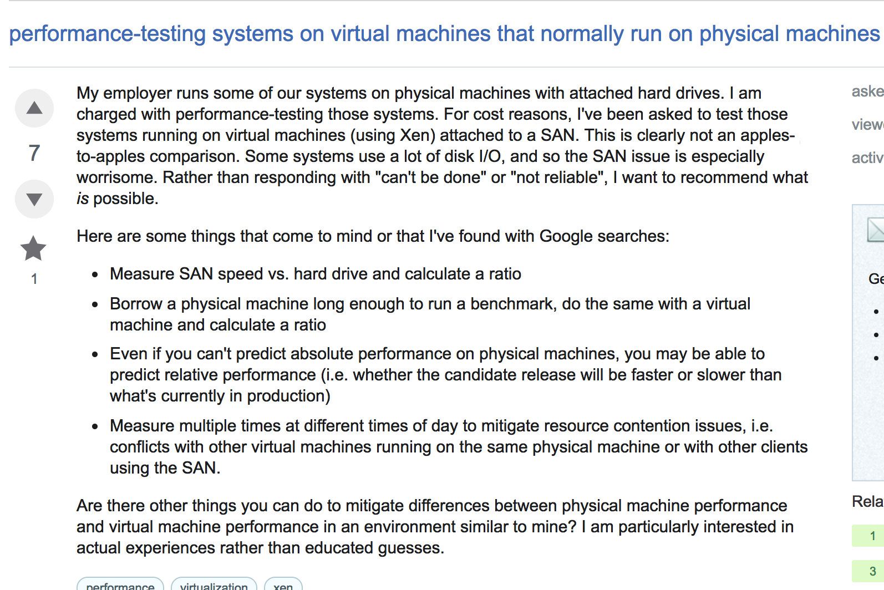
Examples from the industry
https://sqa.stackexchange.com/questions/7709/performance-testing-systems-on-virtual-machines-that-normally-run-on-physical-ma

Slide 12
Examples from the industry
...“For cost reasons, I've been asked to test those systems running on virtual machines (using Xen) attached to a SAN. This is clearly not an apples-to-apples comparison.”...
https://sqa.stackexchange.com/questions/7709/performance-testing-systems-on-virtual-machines-that-normally-run-on-physical-ma
Notes:
Studies have investigated the overhead that is associated with virtual environments. Such overhead may significantly impact the outcome.

Slide 13
Research hypothesis
For software testing activities there exists a discrepancy between physical and virtual environments.
We believe that the approaches used so far do not take into account the heterogeneous environments.
Notes:
For large-scale software systems, performance assurance activities are carried primarily in virtual environments. There is little research regarding the reliability of testing in a different environment compared to physical.

Slide 14
Research Questions
RQ1: Are the trend and distribution of a single performance metric similar across environments?
RQ2: To what extent does the relationship between the performance metrics change across environments?
RQ3: Can statistical performance models be applied across virtual and physical environments?

Slide 15
Approach
Data Collection
Physical Environment
Load Driver
Data Preprocessing
Discrepancy
Virtual Environment
Data Analysis

Slide 16


Approach
Physical Environment
Load Driver
1.Dell DVD Store (DS2) 2. Cloudstore
Virtual Environment
Notes:
Add cloudscale image
We chose these systems because used in this study. Because of load driver. Dvd comes with a load good thing and for cloudstore we used jmeter to replicated the load.

Slide 17
Approach
Both the system are used in prior studies.
DS2 comes with a load driver.
Cloudstore, we used JMeter to replicate the load.
1.Dell DVD Store (DS2) 2. Cloudstore
Notes:
Add cloudscale image
We chose these systems because used in this study. Because of load driver. Dvd comes with a load good thing and for cloudstore we used jmeter to replicated the load.

Slide 18
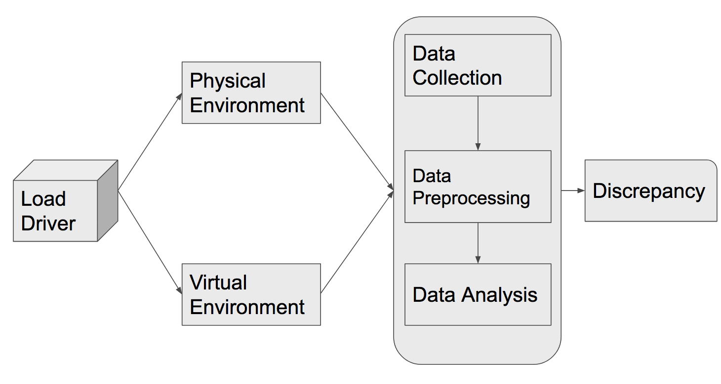
Approach
We set up 3 nodes: Application, database and load driver.
One virtual environment set up on each node: single tenancy.
We set up identical config. between the two environments. i.e. CPU 2 cores, Memory 3GB.
Notes:
Single tenancy to avoid noise from any other virtual machine running. Remove identical.

Slide 19

Approach
Data Collection
Physical Environment
Load Driver
Virtual Environment
Perfmon
Notes:
Performance testing results from virtual and physical environments

Slide 20



Approach
We used PERFMON to monitor application and database server.
We recorded all the performance metrics available.
In total, we recorded 44 performance metrics.
CPU
I/O Ops
Memory
Notes:
Perfmon on process on app and db server.

Slide 21
Approach
Workload variation introduced by number of threads (threads=users) .
The variation of workload was identical, periodic and random across the environments.
Runtime for the test: 9+ hours.
Notes:
Put cpu memory and other stuff throughput is requests finished.

Slide 22
Approach
Data Collection
Physical Environment
Load Driver
Data Preprocessing
Virtual Environment

Slide 23

Approach
System Level
Application Level
CPU
Throughput
Timestamps on logs used to calculate number of request/minute.
I/O Ops
Memory
Notes:
Throughput: we calculate via logs. Metrics recorded every 10 seconds and then averaged out for a minute.
Application level: throughput

Slide 24
Approach
Data Collection
Physical Environment
Load Driver
Data Preprocessing
Virtual Environment
Data Analysis

Slide 25
Approach
1) Examining single performance metric
Data Collection
2) Examining relationship amongst performance metrics
Data Preprocessing
3) Building statistical models using performance metrics
Data Analysis
Notes:
Make sure you emphasize its from slides you discus earlier. After literature review we saw it and thats why we do it.

Slide 26
Approach
1) Examining single performance metric
Data Collection
2) Examining relationship amongst performance metrics
Data Preprocessing
Discrepancy
3) Building statistical models using performance metrics
Data Analysis

Slide 27
Research Questions
RQ1: Are the trend and distribution of a single performance metric similar across environments?
RQ2: To what extent does the relationship between the performance metrics change across environments?
RQ3: Can statistical performance models be applied across virtual and physical environments?

Slide 28
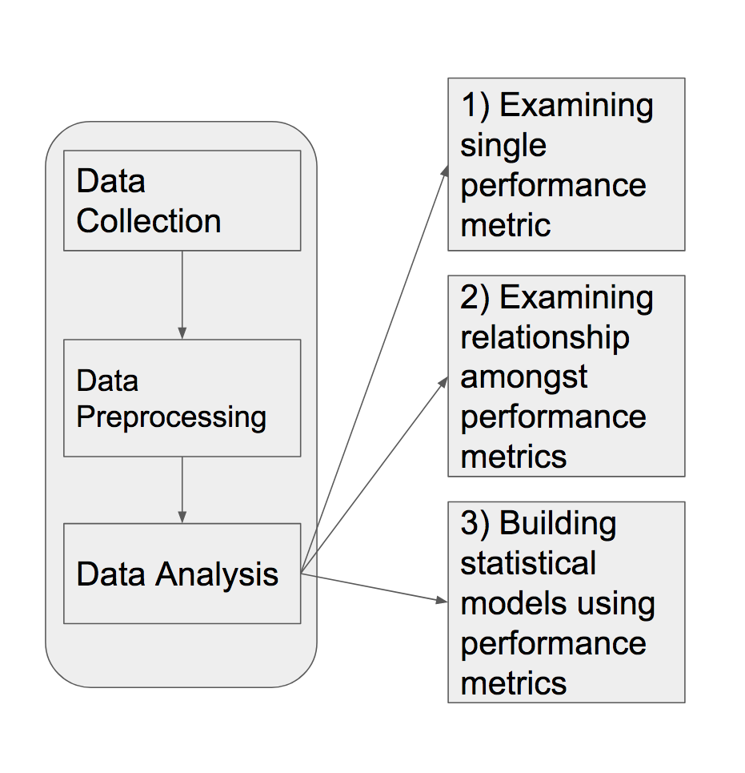
RQ1: Approach
Shape of distribution
Trend
Spearman’s rank correlation coefficient
Quantile-Quantile (QQ)
Plots
Normalized KS-Test
Notes:
Before ks test we normalize the data because the scales are of course not same in the two environments. Normalized through median. The K-S test is sensitive to shifts in the distribution (particularly around the median) while the Kuiper test is sensitive to changes in the tail areas. Rest of the tests are looking into divergence from normality. We select spearman because: 1) no underlying assumption 2) robust to outlier so doesnt change the ranking.

Slide 29
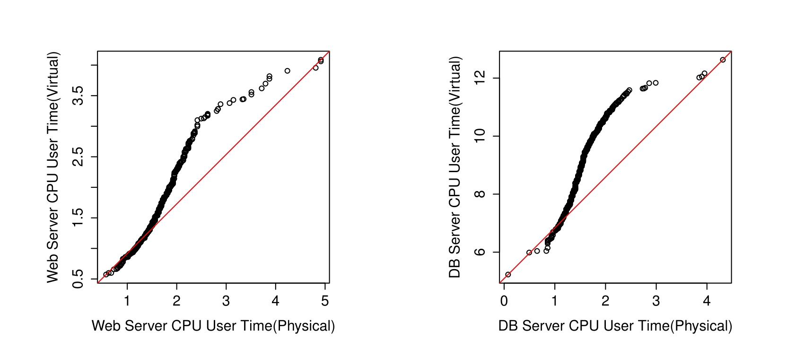
DS2: Most performance metrics do not follow the same shape of the
distribution in virtual and physical environments.
Notes:
Add title shape are different Discuss the distribution

Slide 30
KS-Test: Performance metrics that do not follow the same distribution.
KS-Test (P-value > 0.05)
DS2 | CloudStore
13 | 12
Notes:
Out of the 44 metrics. P values higher than 0.05 Ask meaning of KS-paragraph

Slide 31
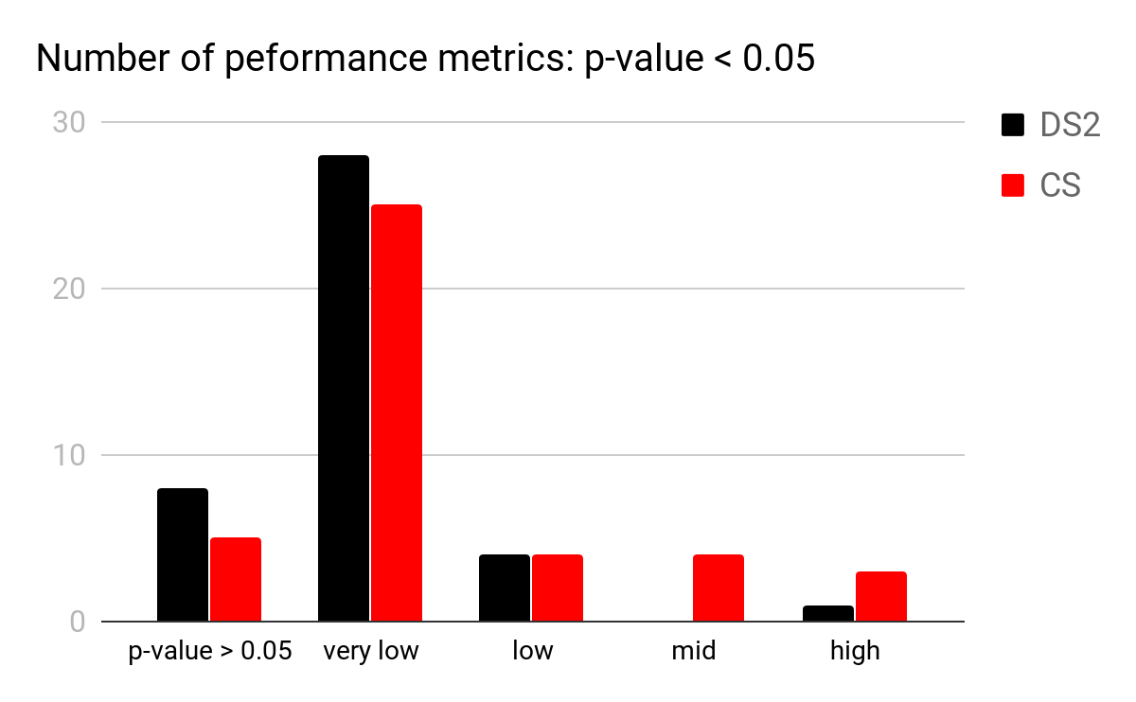
Spearman: Most performance metrics do not have the same trend in virtual and
physical environments.
Notes:
Repeat: to compare the trend Out of the 44 metrics. Three metrics are constant. Therefore, we do no calculate the correlation on those metrics. Correlation is a statistical measure that indicates the extent to which two or more variables fluctuate together.

Slide 32
Research Questions
RQ1: Are the trend and distribution of a single performance metric similar across environments?
RQ2: To what extent does the relationship between the performance metrics change across environments?
RQ3: Can statistical performance models be applied across virtual and physical environments?

Slide 33
RQ2: Approach
Spearman’s rank correlation coefficient:
We calculate against throughput.
We calculate the absolute difference for each pair of metrics. (represented by heatmaps)
Notes:
Why throughput? Because it is constant between the two environments. Absolute difference example: for example cpu and memory have correaltion of 0.3 in one enviornment and 0.5 in another environment. The absolute difference is going to be |0.3-0.5|=0.2

Slide 34
Spearman: The rank of the metrics changes across the environments.
The rank (vs. throughput) of the metrics is not the same in the two environments.
#9
#40
#1
#10
Notes:
#9 to #40 DS2, #1 to #10 in cloudstore.

Slide 35
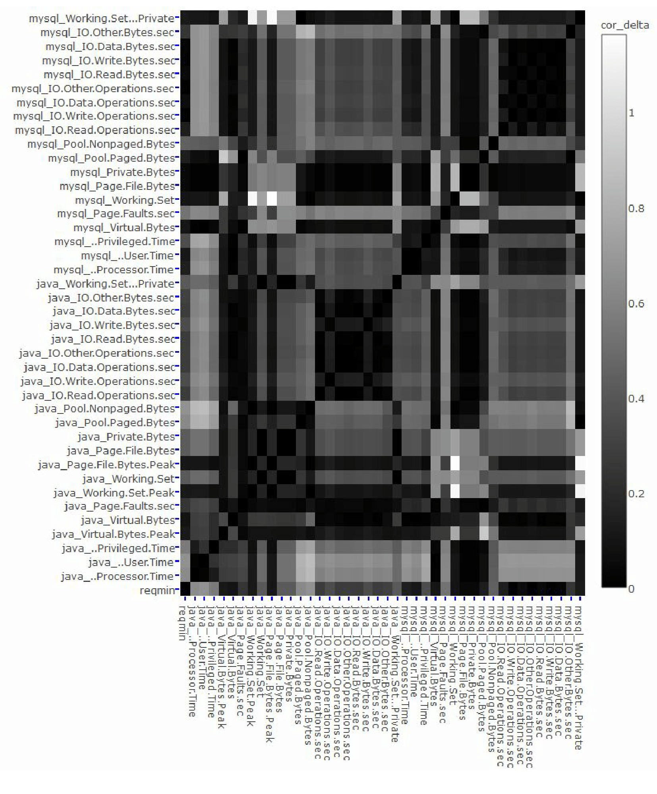
CS: Heatmap
Notes:
The correlations between performance metrics and system load may change considerably between virtual and physical environments. The correlation among performance metrics may also change considerably between virtual and physical environments. The correlations that are related with I/O metrics have the largest discrepancy.

Slide 36
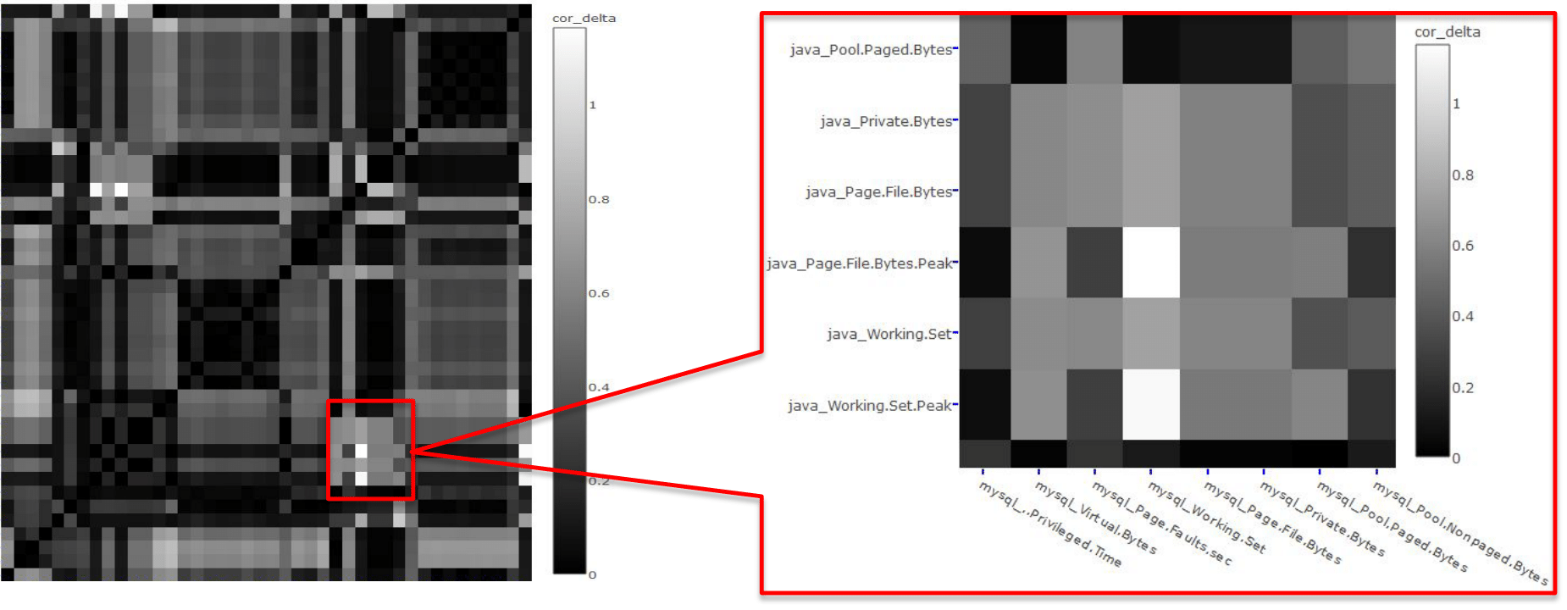
CS: There exist differences in correlation among the performance metrics from
virtual and physical environments.
Notes:
The correlations between performance metrics and system load may change considerably between virtual and physical environments. The correlation among performance metrics may also change considerably between virtual and physical environments. The correlations that are related with I/O metrics have the largest discrepancy.

Slide 37
Research Questions
RQ1: Are the trend and distribution of a single performance metric similar across environments?
RQ2: To what extent does the relationship between the performance metrics change across environments?
RQ3: Can statistical performance models be applied across virtual and physical environments?

Slide 38
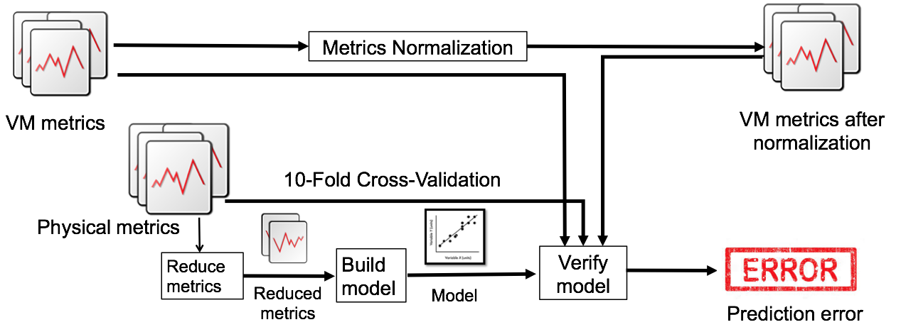
RQ3: Approach - Statistical modelling
Normalization by deviance
Normalization by load
Data Cleanup:
Constant metrics
Multicollinear metrics
Redundant metrics
Stepwise function
Notes:
System throughput as our independent variable. Why did we use wald statistic?

Slide 39
RQ3: Approach - Statistical modelling
Notes:
System throughput as our independent variable. Why did we use wald statistic?

Slide 40
RQ3: Model Verification
Two types of model verification:
Internal Validation
External Validation after:
We normalize by deviance
We normalize by load
Notes:
Internal to see if our model is crappy, if model is crappy there is no point of comparing. External: applying models virtual to physical and vice versa.

Slide 41
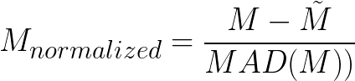
RQ3: Model Verification
External Validation
Normalization by deviance

Slide 42
RQ3: Model Verification
External Validation
Normalization by deviance
Followed by a min-max normalization to avoid calculation errors for negative values.
Notes:
Min max because to avoid getting errors

Slide 43
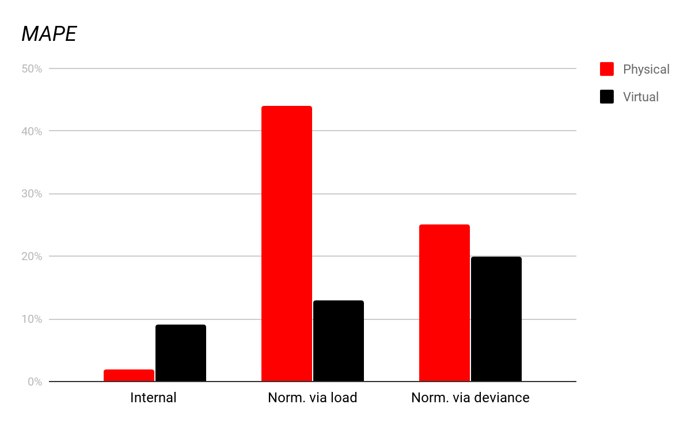
Discrepancy - DS2: We find that the statistical models built by performance testing results
in an environment cannot advocate for the other environment due to discrepancies
present.
Notes:
As there are varying inputs for the performance tests that we carried out, normalization by load helps in normalizing the multi-modal distribution that might be because of the trivial tasks like background processes(bookkeeping). We equate throughputs? But then how can throughputs be same? Because thanhs assumption is throughput is correlated with metric. So with different throughputs we should have

Slide 44
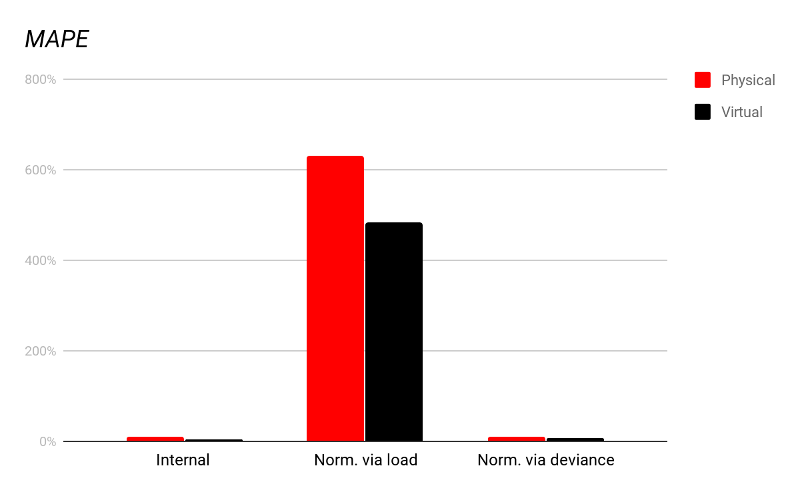
Discrepancy - CS: We find that the statistical models built by performance testing results
in an environment cannot advocate for the other environment due to discrepancies
present.
Notes:
As there are varying inputs for the performance tests that we carried out, normalization by load helps in normalizing the multi-modal distribution that might be because of the trivial tasks like background processes(bookkeeping). We equate throughputs? But then how can throughputs be same? Because thanhs assumption is throughput is correlated with metric. So with different throughputs we should have

Slide 45
Examining the impact from other factors on our results
Instability of the virtual environment
Impact of the specific virtual machine software
Impact of allocated resources

Slide 46


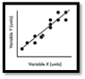
Instability of the virtual environment
Repeat tests
Build models
Compare externally

Slide 47
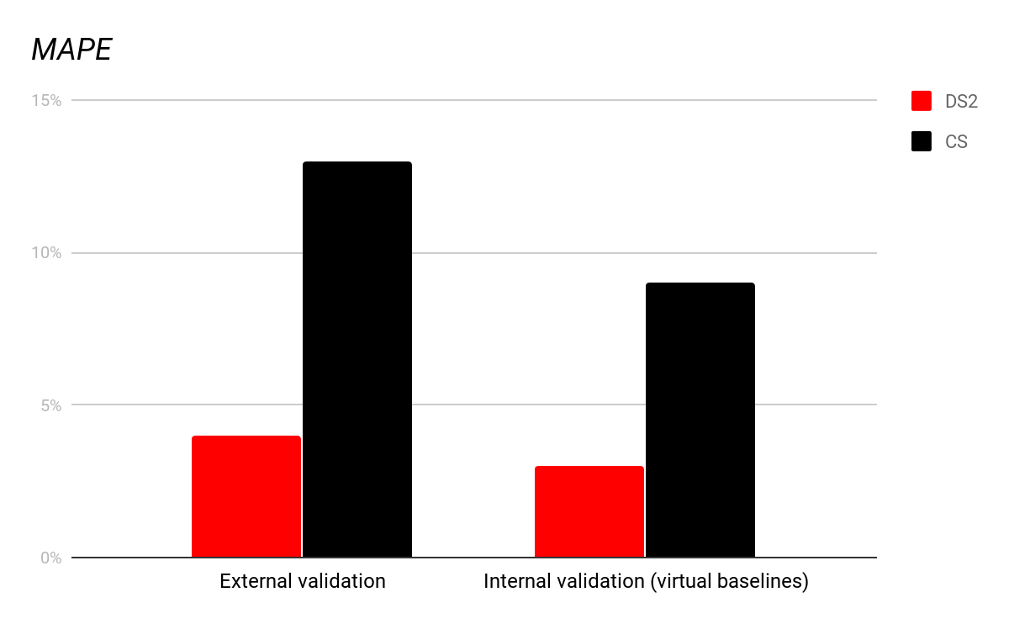
Performance testing results from the virtual environments are stable.

Slide 48
2. Impact of the specific virtual machine software
VirtualBox
VMWare
Training
Testing
Normalized Physical

Slide 49
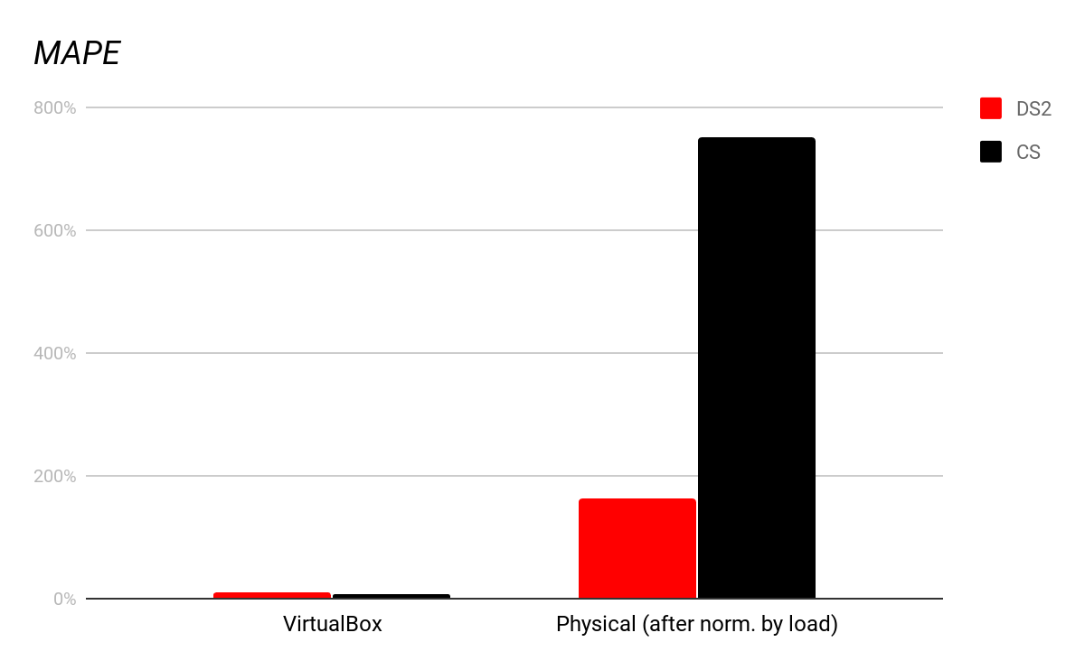
2. Discrepancy observed
during our experiment also exists with the virtual environments that are set up with
VMWare.

Slide 50
3. Impact of allocated resources
Modify configuration
Build models
Compare externally
We increase the resources to 3 cores and 5GB memory.

Slide 51
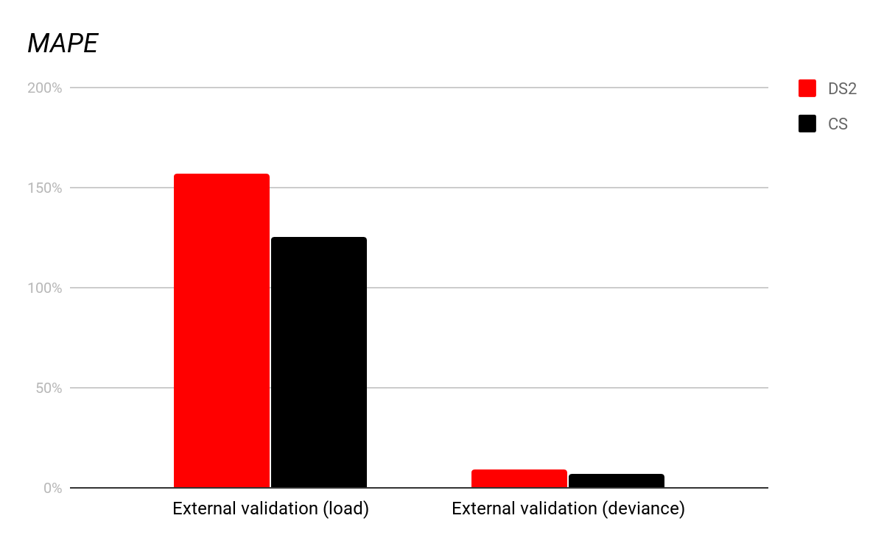
3. Our findings still hold when the allocated
resources are changed and this change has minimal impact on the results of our case
studies.

Slide 52
Contributions
This is the first research attempt to evaluate the discrepancy between performance testing results in virtual and physical environments.
We identified the performance metrics that contribute the most to the discrepancies.
We find that normalizing performance metrics based on deviance may reduce the discrepancy

Slide 53
Implications
Practitioners cannot assume a straight forward overhead.
Practitioners should always verify whether the inconsistency of correlations between performance metrics are due to virtual environments.
Normalization by deviance may minimize such discrepancy.
Notes:
Verification of inconsistencies between the two environments. For example the role of i/o metrics.

Slide 54
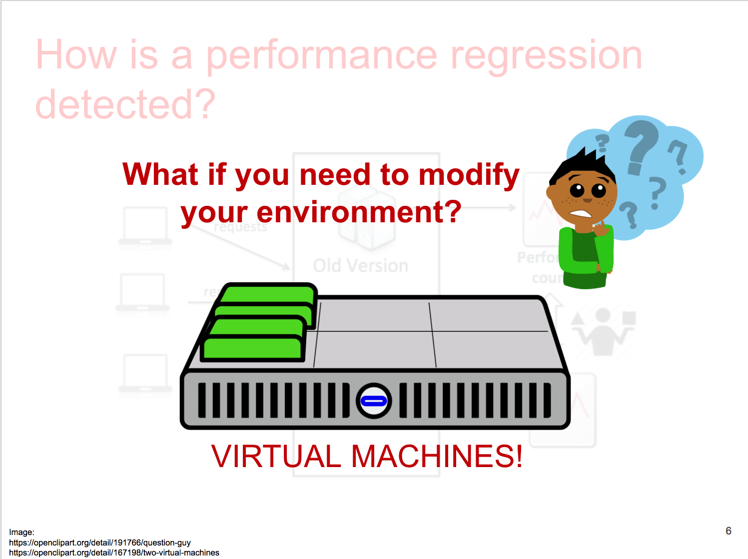
Summary
Notes:
We also talk about threats to validity and future work

Slide 55
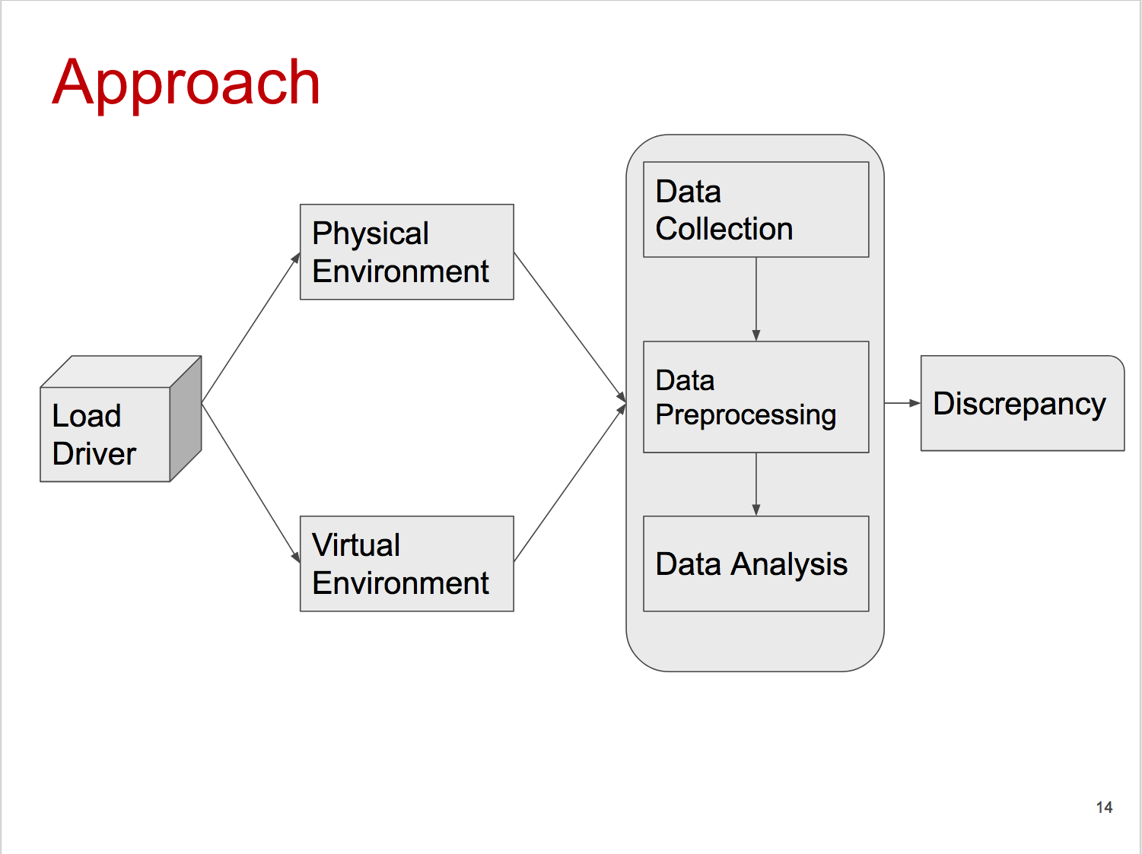
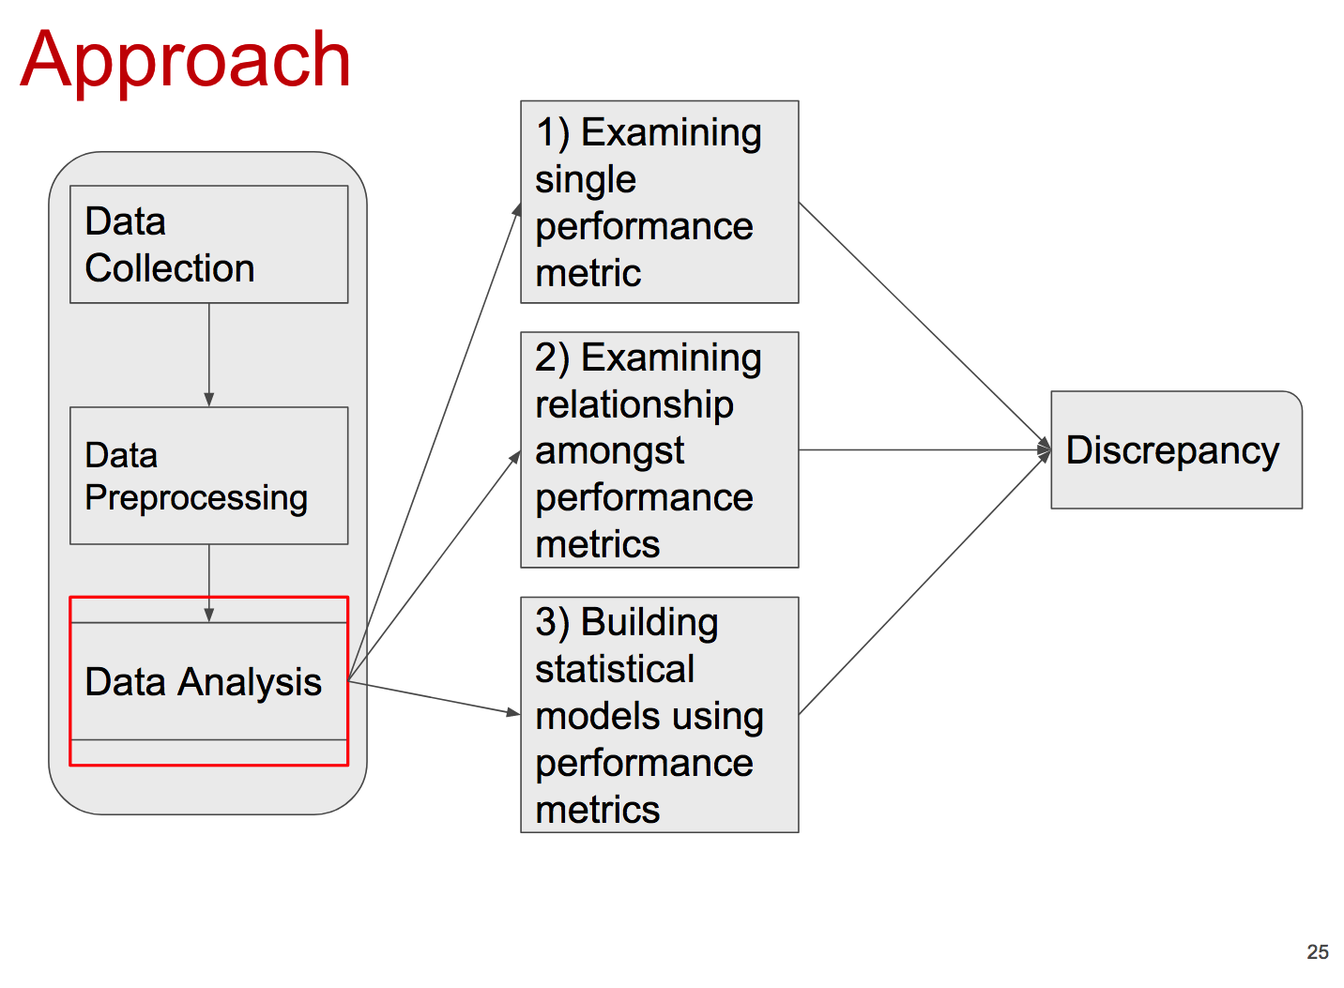
Summary
Notes:
We also talk about threats to validity and future work

Slide 56
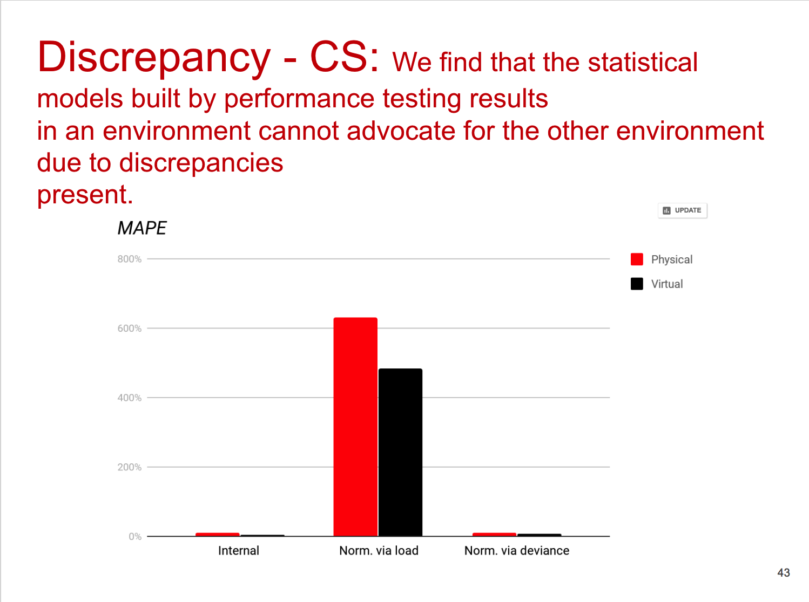
Summary
Notes:
We also talk about threats to validity and future work

Slide 57
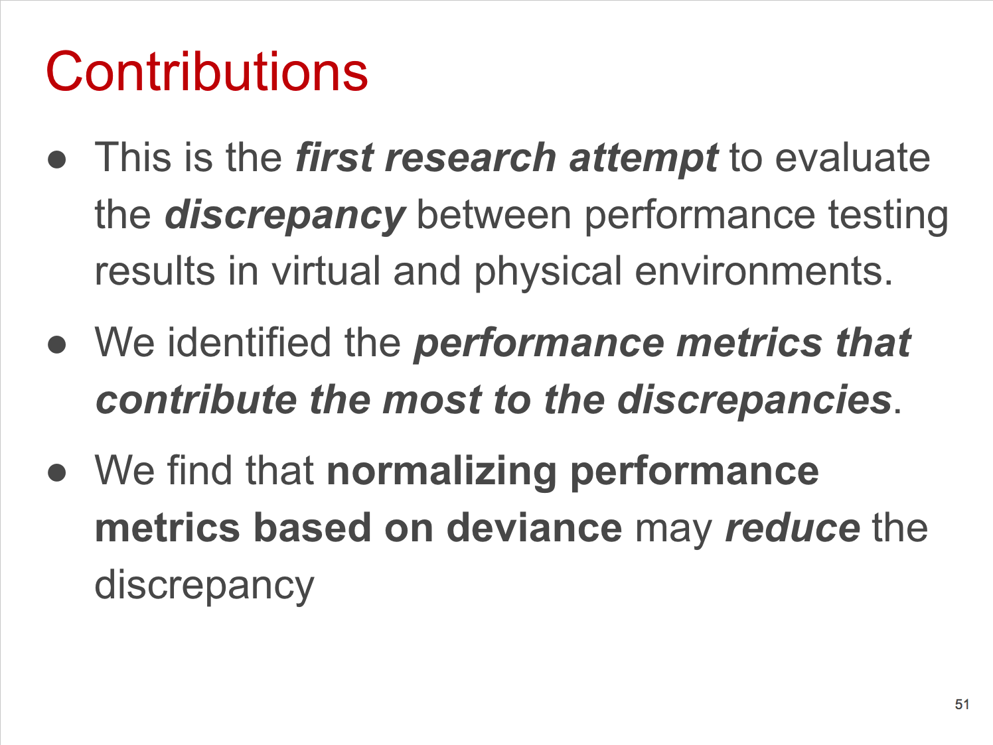
Summary
Notes:
We also talk about threats to validity and future work

Slide 58
Summary
Notes:
We also talk about threats to validity and future work

Slide 59
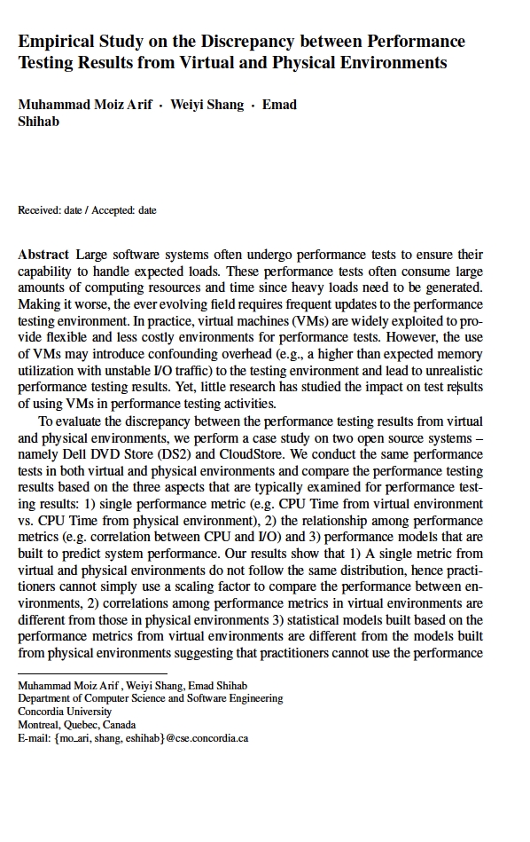
Publications
EMSE - Major revision submitted
Notes:
No major concerns. Don’t say we are waiting it will be accepted.

Slide 61
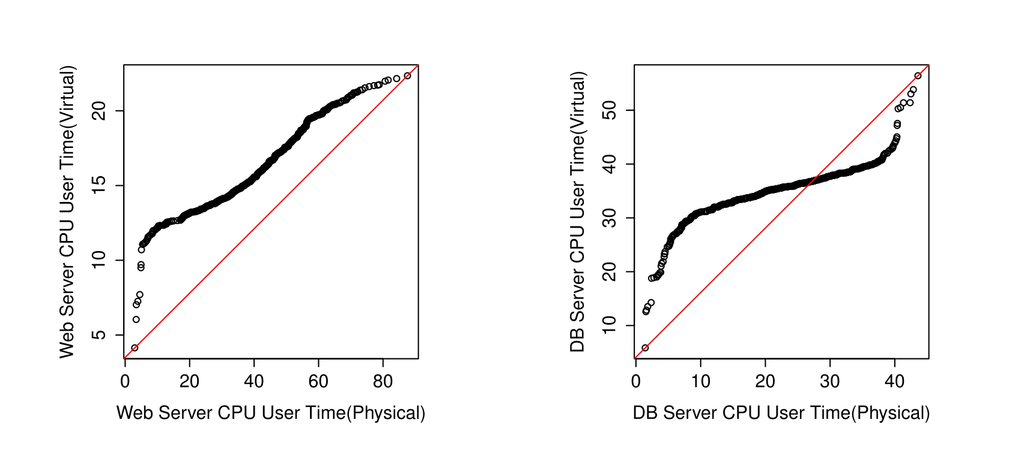
CS: Most performance metrics do not follow the same shape of the
distribution in virtual and physical environments.

Slide 62
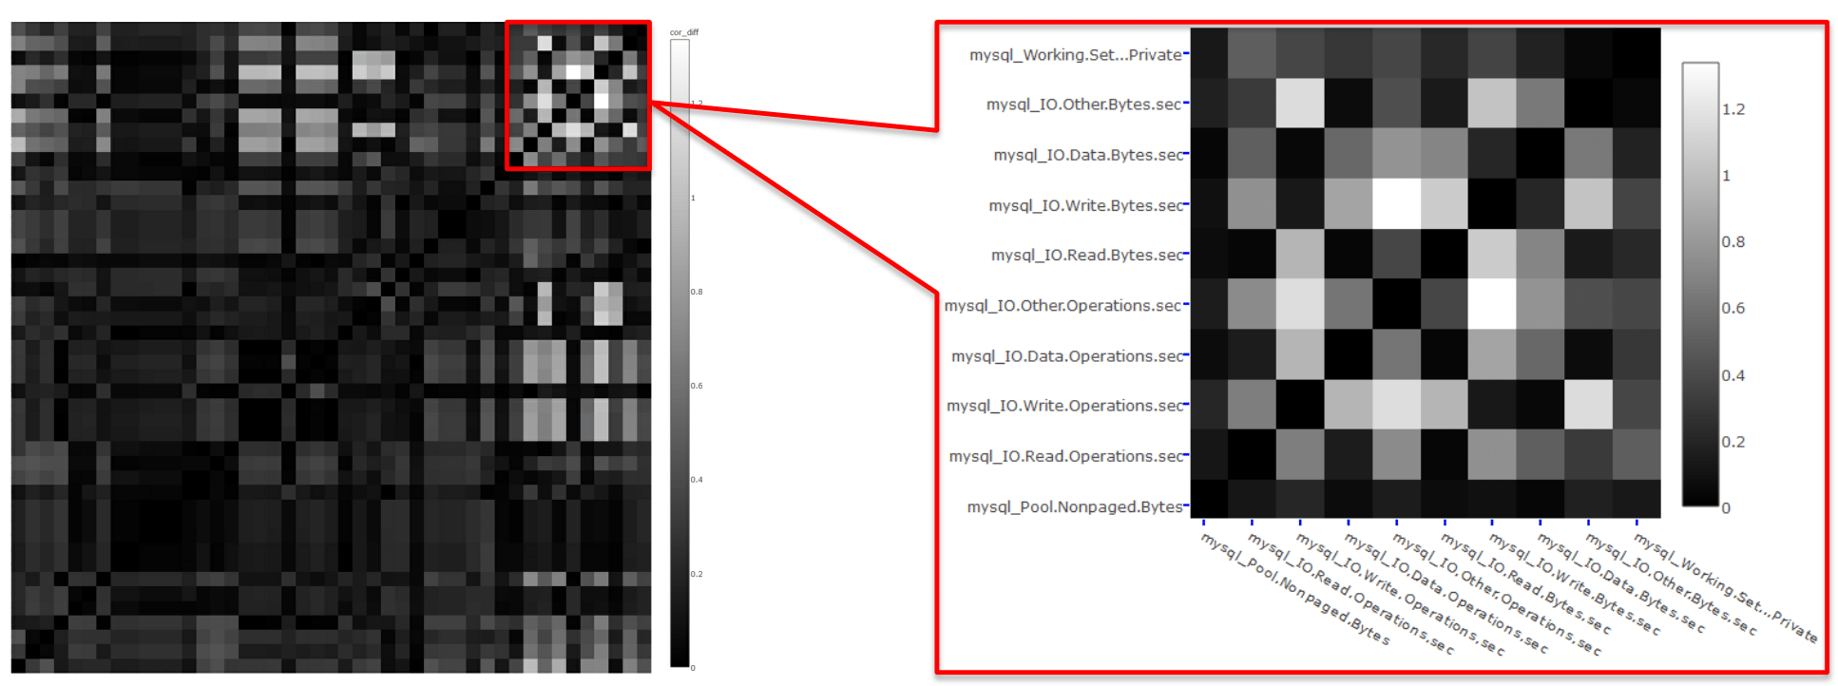
DS2: Heatmap

Slide 63
Model Verification
Internal Validation
Ten-fold Cross validation
k=1 | Test | Train | Train | Train | Train | Train | Train | Train | Train | Train
k=2 | Train | Test | Train | Train | Train | Train | Train | Train | Train | Train
k=3 | Train | Train | Test | Train | Train | Train | Train | Train | Train | Train
... | ... | ... | ... | ... | ... | ... | ... | ... | ... | ...
k=10 | Train | Train | Train | Train | Train | Train | Train | Train | Train | Test

Slide 64
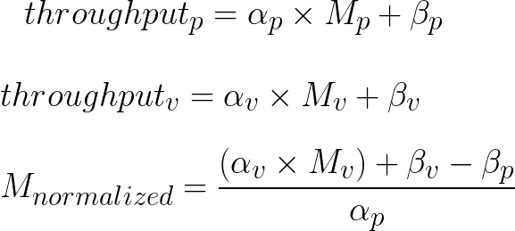
Model Verification
External Validation
Normalization by load
Notes:
As there are varying inputs for the performance tests that we carried out, normalization by load helps in normalizing the multi-modal distribution that might be because of the trivial tasks like background processes(bookkeeping). We scaled the tested environment. We equate throughputs? But then how can throughputs be same?

Slide 65
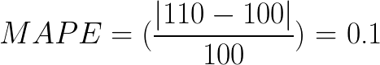
Discrepancy: Absolute % Error
Median Absolute Percentage Error (MAPE)
Throughput: 100 requests/minute
Predicted: 110 requests/minute
Notes:
As there are varying inputs for the performance tests that we carried out, normalization by load helps in normalizing the multi-modal distribution that might be because of the trivial tasks like background processes(bookkeeping). We equate throughputs? But then how can throughputs be same?

Slide 66
Limitations
More case studies
Quality of performance tests and recorded values.
Other types of workload variation.
Hint of overfitting of models.
Choice of intervals (for e.g. 9 hours, 10 seconds)
The complete system: user’s point of view.

Slide 67
Future Work
Reproducing known performance regressions in heterogeneous environments.
Replicating our experiments in cloud environments.
Designing automating techniques.

